Slide 1

CMSC 137
Data Communications and Networking
Lecture Module
17 – Wireless LAN

Slide 2
Module 17: Wireless LAN
Rozano S. Maniaol
Lecturer

Slide 3
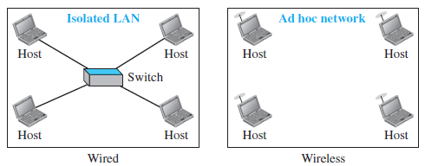
Introduction
Architectural Comparison
  Medium: Wired LANS use wires, wireless LANs use air
  Hosts: Wired LAN is always connected with fixed link layer address, wireless LAN not physically connected
  Isolated LANs: Wired LAN is a set of host connected via a link layer switch, wireless LAN is a set of hosts that can communicate freely

Slide 4
Introduction
Characteristics
  Attenuation: signals decrease rapidly since it is disperse in all directions
  Interference: may receive from other senders if they are using the same frequency band
  Multipath propagation: may receive more than one signal from the same sender due to reflection on from some obstacles; may receive signal at different phases
  Error: errors and error detection are more serious issues in wireless network

Slide 5
IEEE 802.11

Slide 6
IEEE 802.11
Specifications for wireless LAN which covers the physical and data link layer (sometimes called wireless Ethernet)
Wireless Fidelity (WiFi) – wireless LAN that is certified by the WiFi Alliance
Architecture:
  Defines two kinds of services: basic service set (BSS) and extended service set (ESS)

Slide 7
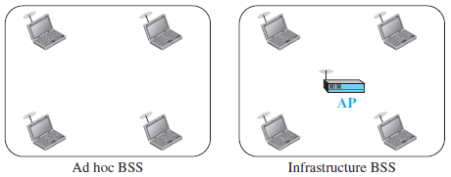
Basic Service Set
BSS – building block of a wireless LAN
  Made up of stationary or mobile wireless stations and an optional central base station, access point (AP)
  Ad hoc – BSS without AP
  Infrastructure – BSS with AP

Slide 8
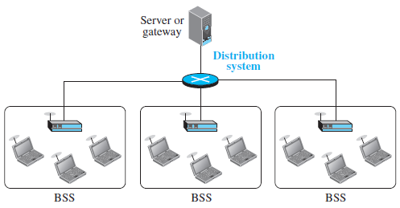
Extended Service Set
ESS – made up of two or more BSSs with APs; BSS are connected through a distribution system, usually a wired LAN
Mobile or stationary stations

Slide 9
IEEE 802.11
Station Types:
  No-transition – stationary or moving only inside a BSS
  BSS-transition – station can move from one BSS to another confined inside one ESS
  ESS-transition mobility – station can move from one ESS to another
IEEE does not guarantee that communication is continuous

Slide 10
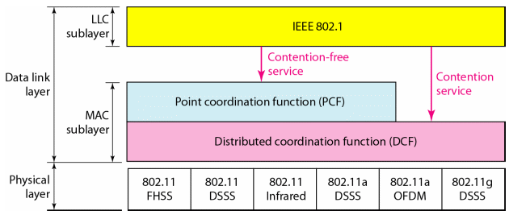
IEEE 802.11 MAC Layer
1

Slide 11
Distributed Coordination Function (DCF)
Uses CSMA/CA
Cannot use CSMA/CD because:
  Station must send and receive at the same time; costly
  Collision may not be detected because of hidden station problem
  Distance between stations may be great

Slide 12
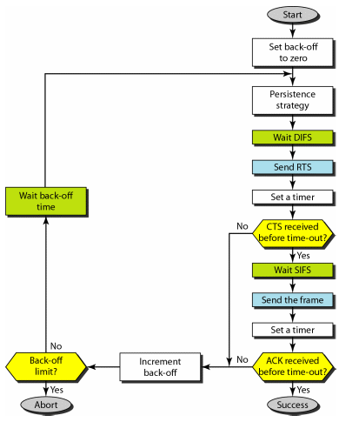
CSMA/CA Flowchart
Abbreviations
DIFS – distributed interframe space
RTS – request to send
SIFS – short interframe space
CTS – clear to send

Slide 13
Network Allocation Vector (NAV)
How other stations defer sending their data if one station acquires access?
  When a station sends an RTS frame, it includes the duration of time it needs to occupy the channel
  Station affected by the transmission creates a timer called NAV
Each station, before sensing the physical medium to see if it is idle, first checks to see its NAV to see it it has expired
During handshaking – no CTS means collision

Slide 14
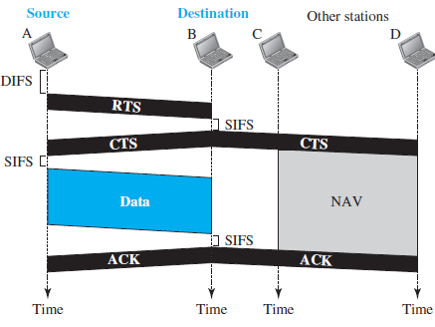
CSMA/CA and NAV

Slide 15
Point Coordination Function (PCF)
Optional access method for time-sensitive transmission
Can be implemented in an infrastructure network only
Centralized, contention-free polling access method
PIFS and SIFS, PIFS shorter than DIFS (gives higher priority to PCF over DCF)

Slide 16
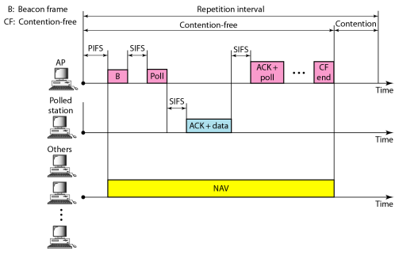
PCF
Repetition interval - allow DCF stations to access the medium(when PCF is present)

Slide 17
Fragmentation
Wireless environment is very noisy
Corrupted frames must be re-transmitted
More efficient to resend small frames than a large one

Slide 18
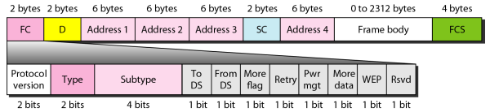
IEEE 802.11 Frame Format

Slide 19
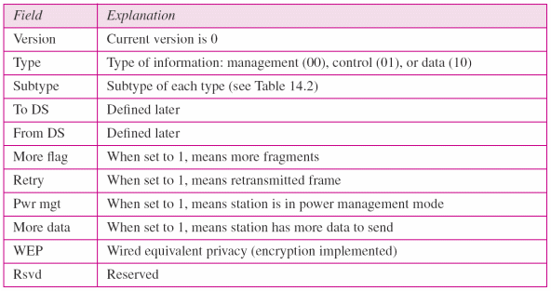
IEEE 802.11 Frame Format
Frame Control (FC) – defines the type of frame and some control information

Slide 20
IEEE 802.11 Frame Format
D – duration of the transmission that is used to set the value of NAV
Addresses – four 6-byte addresses (depends on the value of TO DS and FROM DS
Sequence control – sequence number of the frame to be used in flow control
Frame body – can be between 0 and 2312 bytes; info depends on the type and subtype in FC
FCS - CRC-32

Slide 21

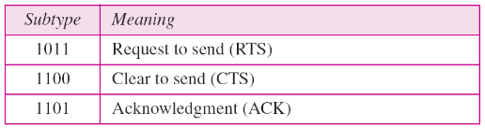
Frame Types
Management Frames – initial communication
Data Frames - data
Control Frames – accessing the channel and acknowledging frames; type field: 01

Slide 22
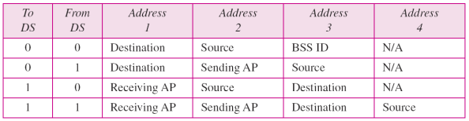
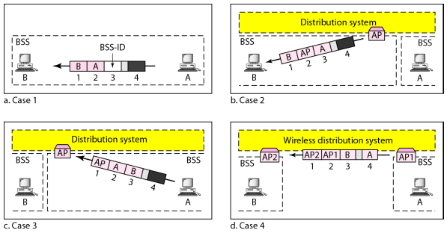
Addressing Mechanism

Slide 23
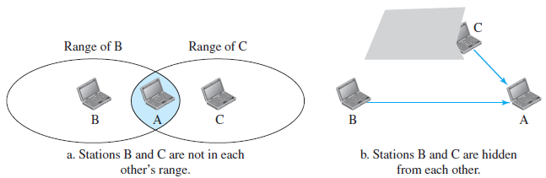
Hidden Station Problem
Can reduce the capacity of the network because of collision

Slide 24


Hidden Station Problem
Handshaking to solve HSP using CTS frame
B
A
C
RTS
CTS
CTS
Time
Time
Time

Slide 25
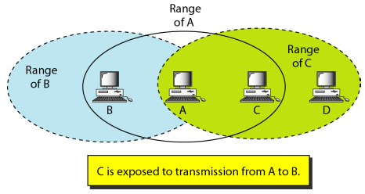
Exposed Station Problem
Station refrains from using the channel even when it is available

Slide 26
Exposed Station Problem
B
A
C
D
RTS
RTS
C can send to D because this area is free, but C erroneously refrains from sending because of the received RTS
CTS
A is sending data to B
C is sending data to D
DATA
DATA
If C sends, the collision would be in this area
Time
Time
Time
Time

Slide 27
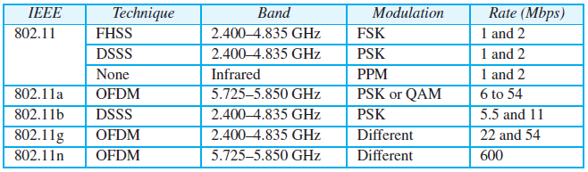
IEEE 802.11 Physical layer

Slide 28
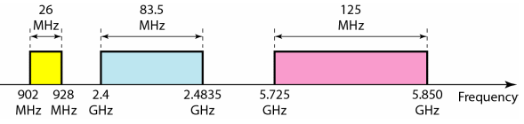
ISM Band
Internationally reserved portion of the radio frequency bands for Industrial, Scientific, and Medical uses; no need for government licenses
Opened up for Wireless LANs and mobile communications,

Slide 29
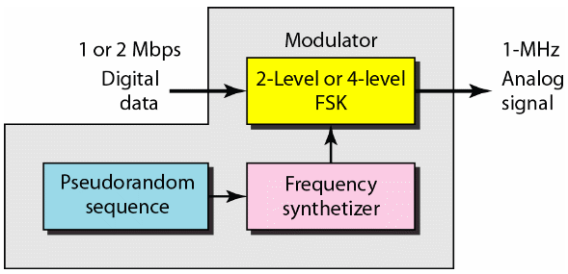
IEEE 802.11 FHSS
Band is divided into 79 subbands of 1 MHz (and some guard bands)

Slide 30
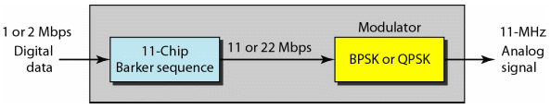
IEEE 802.11 DSSS
Modulation technique is PSK at 1 Mbaud/s

Slide 31
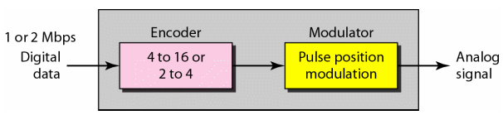
IEEE 802.11 Infrared
Infrared light in the range of 800 to 950 nm
Pulse Position Modulation (PPM)
Mapped sequence are converted to optical signals, presence of light specifies 1, absence of light specifies 0

Slide 32
IEEE 802.11a OFDM
Orthogonal frequency-division multiplexing (OFDM) - same as FDM except all sub bands are used by one source at a given time
5.725 – 5.850 GHz ISM band
Band is divided into 52 subbands with 48 groups of bits at a time and 4 subbands for control information
Uses PSK (18 Mbps) and QAM (54 Mbps)

Slide 33
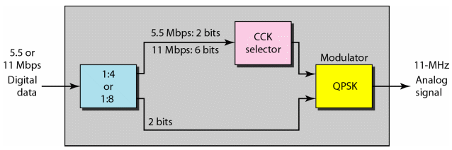
IEEE 802.11b DSSS
High-rate direct sequence spread spectrum (HR-DSSS)
2.400 – 4.835 GHz ISM
Uses complementary code keying (CCK)
Encode 4 or 8 bits to one CCK symbol

Slide 34
IEEE 802.11g
Defines forward correction and OFDM using the 2.400 – 4.835 GHz ISM band
22- or 54-Mbps data rate
Backward compatible with 802.11b but modulation technique is OFDM

Slide 35
IEEE 802.11n
Upgrade to 802.11 project called 802.11n (next generation of wireless LAN)
Goal is to increase throughput of wireless LAN (some have reached up to 600 Mbps data rate)
Eliminated some unnecessary overhead
  Uses multiple-input multiple-output antenna (MIMO)
    If it can send multiple output signals and receive multiple signals, it is in better position to eliminate noise
Relabeled as WiFi 4

Slide 36
Latest standards
802.11ac – relabeled as WiFi 5
  Frequency band: 5.8 Ghz ISM band; Max data rate: 6.93 Gbps
  Implements Multi-User MIMO (MU MIMO) which enables simultaneous transmission of different data frames to different clients
802.11ax – relabeled as WiFi 6
  Frequency bands: 2.4 Ghz and 5 Ghz, 6Ghz for WiFi 6E
  Multiuser technology: OFDMA + MU MIMO
  Maxdata Rate: 600.4 Mbps (80 Mhz channel & 1 spatial stream), 9607.8 Mbps (160 Mhz channel & 8 spatial streams)

Slide 37
Bluetooth

Slide 38
Bluetooth
Wireless LAN technology designed to connect devices of different functions such as telephones, notebooks, computers (desktop and laptop), cameras, etc.
An ad hoc network - piconet
Network cannot be large
Started as a project by the Ericsson Company
From the word “Blaatand”

Slide 39
Bluetooth
Piconet
  May have up to 8 nodes; one primary others secondary
Scatternet
  Combination of Piconets
  A secondary station in one piconet can be the primary in another
  A station can be a member of two piconets
Current data rate of 1Mbps with 2.4 GHz bandwidth – can cause interference with 802.11b

Slide 40
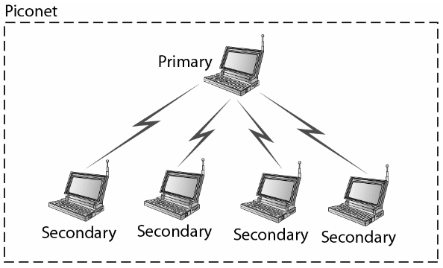
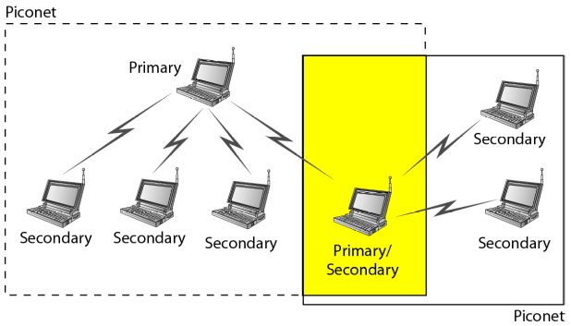
Bluetooth

Slide 41
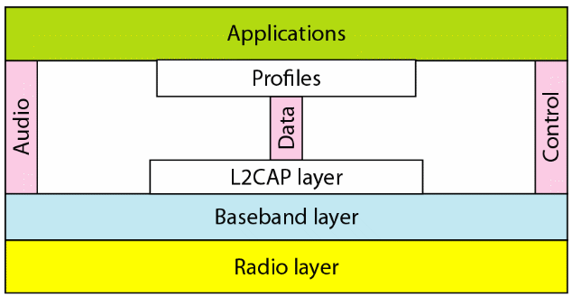
Bluetooth Layers

Slide 42
Radio Layer
Equivalent to the physical layer
Range of 10m
2.4-GHz ISM band divided into 79 channels of 1 MHz each
FHSS – hops 1600 times per second
Uses Gaussian FSK for modulation

Slide 43
Baseband Layer
Equivalent to the MAC sublayer
Uses Time-Division Duplex TDMA
Communication is between primary and secondaries only
If there is one secondary, time slot is divided into 625 micro seconds with the primary using even-numbered slots and secondary using odd-numbered slots

Slide 44
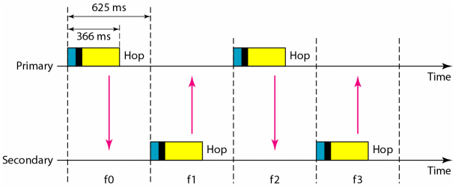
Baseband Layer
Single secondary communication;primary uses even numbered slots

Slide 45
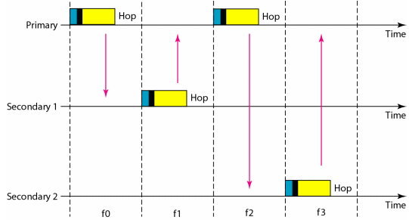
Baseband Layer
Multiple-secondary communication;similar to poll/select with reservations

Slide 46
Links
Synchronous connection-oriented (SCO) – used when avoiding latency is more important than integrity; no re-transmission
  Reserves two slots at regular intervals
  Used in real-time audio
Asynchoronous connectionless link (ACL) – used when data integrity is more important than latency; with re-transmission

Slide 47
Frame Format
Three types: one-slot, three-slot, five-slot
A slot is 625 microseconds
One-slot: with 1-MHz bandwidth and 1 bit/Hz, size is 366 bits
Three-slot: size is 1616 bits
Five-slot: size is 2866 bits

Slide 48
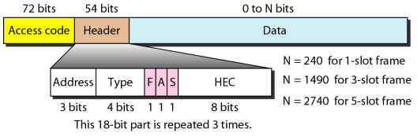
Frame Format
Access code – 72-bits; sync bits; primary id
Header – 54 bits in a repeated 18-bit pattern
  Address – secondaries id
  Type – type of data
  F – flow control, A – ACK, S – seq #, HEC – checksum
Data – 0 to 2740 bits

Slide 49
L2CAP
Logical Link Control and Adaptation Protocol
Roughly equivalent to the LLC sublayer
Used for exchange in ACL link
Allows multiplexing, segmentation and reassembly, QoS, and Group Management

Slide 50
References
Electronic Notes. WiFi Standards: IEEE 802.11. https://www.electronics-notes.com/articles/connectivity/wifi-ieee-802-11/standards.php
Forouzan, B.A. 2013. Data Communications and Networking, 5th Ed. McGraw-Hill, New York.

